Slide 1
INTRO
cloud computing is a way to share distributed resources and services that belongs to different organizations and sites since cloud computing shares distributed resources via network in the open environment thus it makes the security problems
in this method some important security services including authentication encryption, decryption and compression are provided.

Slide 2

PROBLEM STATEMENT
The privacy and security concerns will surely differ between a consumer using a public cloud application and a medium- sized enterprise using a customized suite of business applications on a cloud platform and this brings a different package of benefits and risks. What remains constant, though, is the real value that the user seeks to protect.in era of personal privacy personal data should really protect

Slide 3

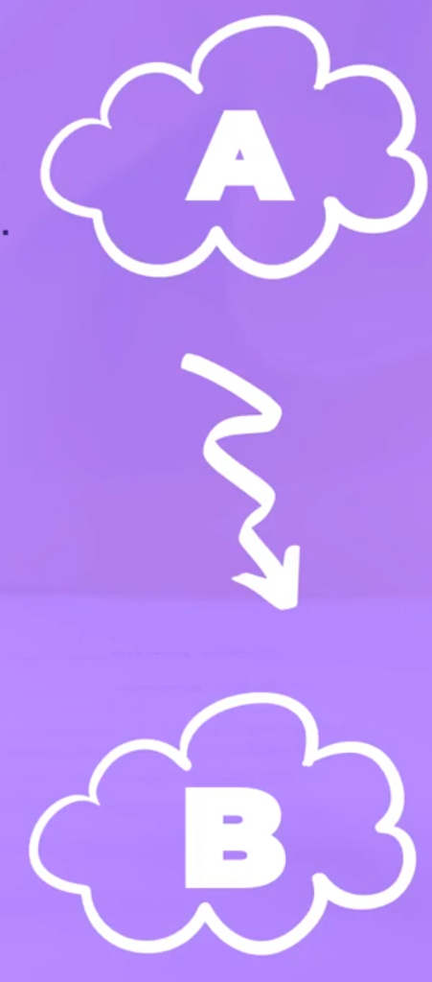

PROPOSED STATEMENT
SECURE DATA TRANSFER FROM CLOUD TO CLOUD LET US ASSUME THAT WE HAVE TWO ORGANIZATIONS A AND B. A AND B ACT AS PUBLIC CLOUDS WITH DATA, SOFTWARE AND APPLICATIONS. A WANT TO SEND DATA TO B'S CLOUD SECURELY AND DATA SHOULD BE AUTHENTICATED. WE ARE HERE TRYING TO SEND A SECURE DATA FROM A TO B BY APPLYING DIGITAL SIGNATURE AND DATA ENCRYPTION. SUPPOSE B WANTS AN XML DOCUMENT FROM A'S CLOUD THEN B'S USER WILL PLACE A REQUEST TO A'S USER. A'S USER SELECTS CORRESPONDING XML DOCUMENT FROM A'S CLOUD DATA STORAGE AND THEN APPLY THE HASH FUNCTION, IT WILL GIVE MESSAGE DIGEST. SIGN THE MESSAGE DIGEST WITH HIS PRIVATE KEY BY USING A'S SOFTWARE.IT IS CALLED DIGITAL SIGNATURE

Slide 4
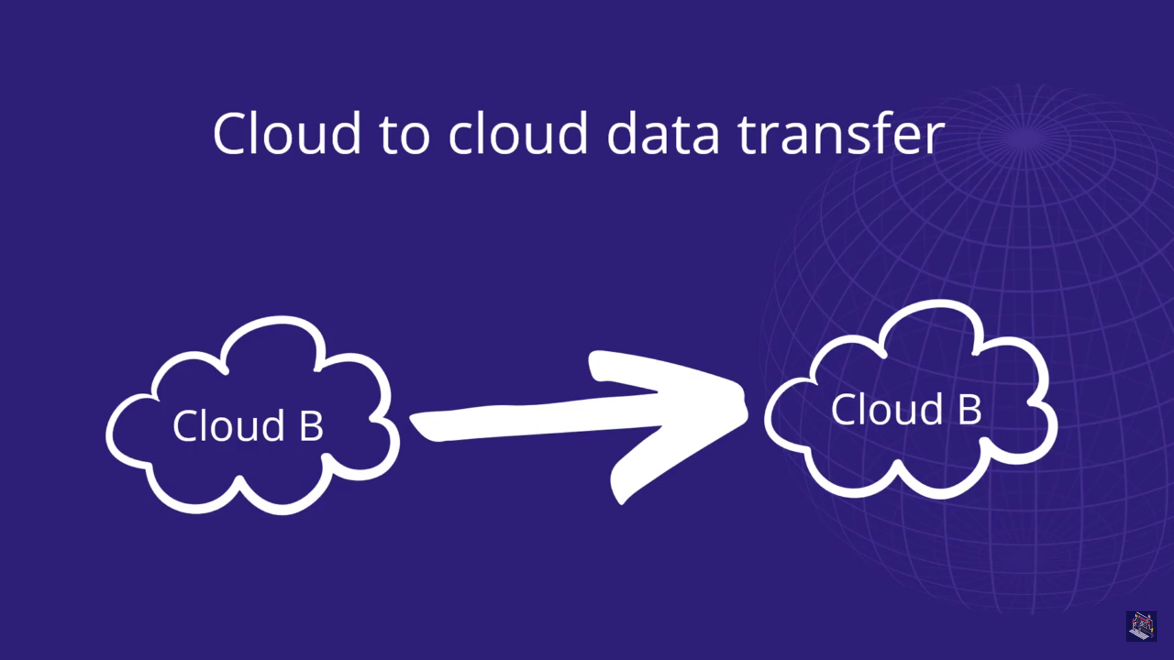

Slide 5
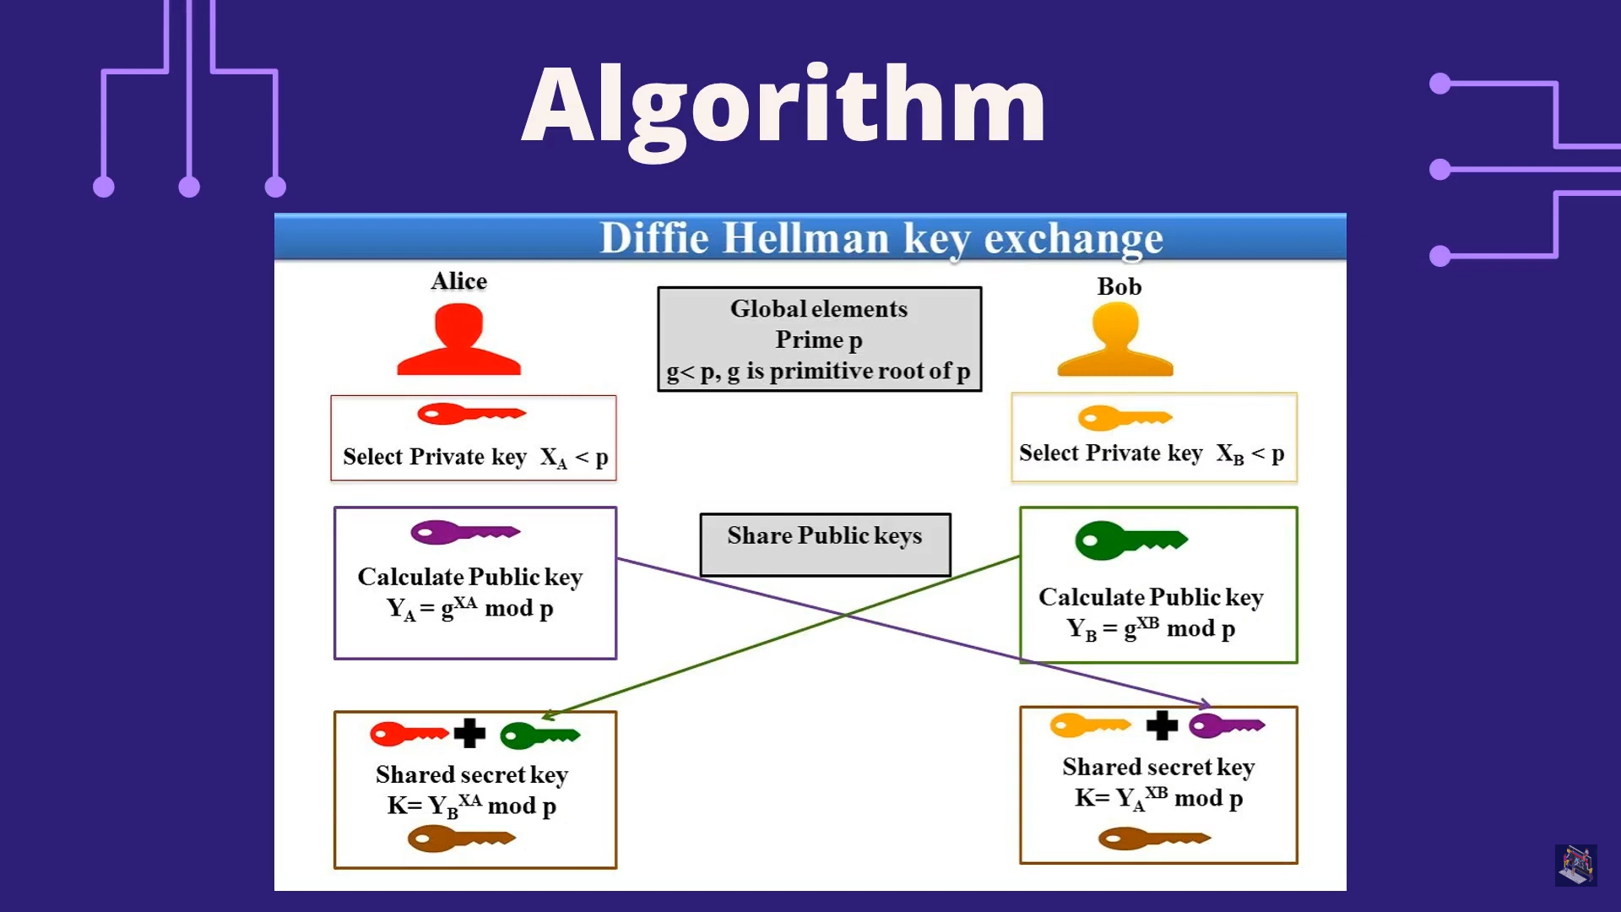

Slide 6
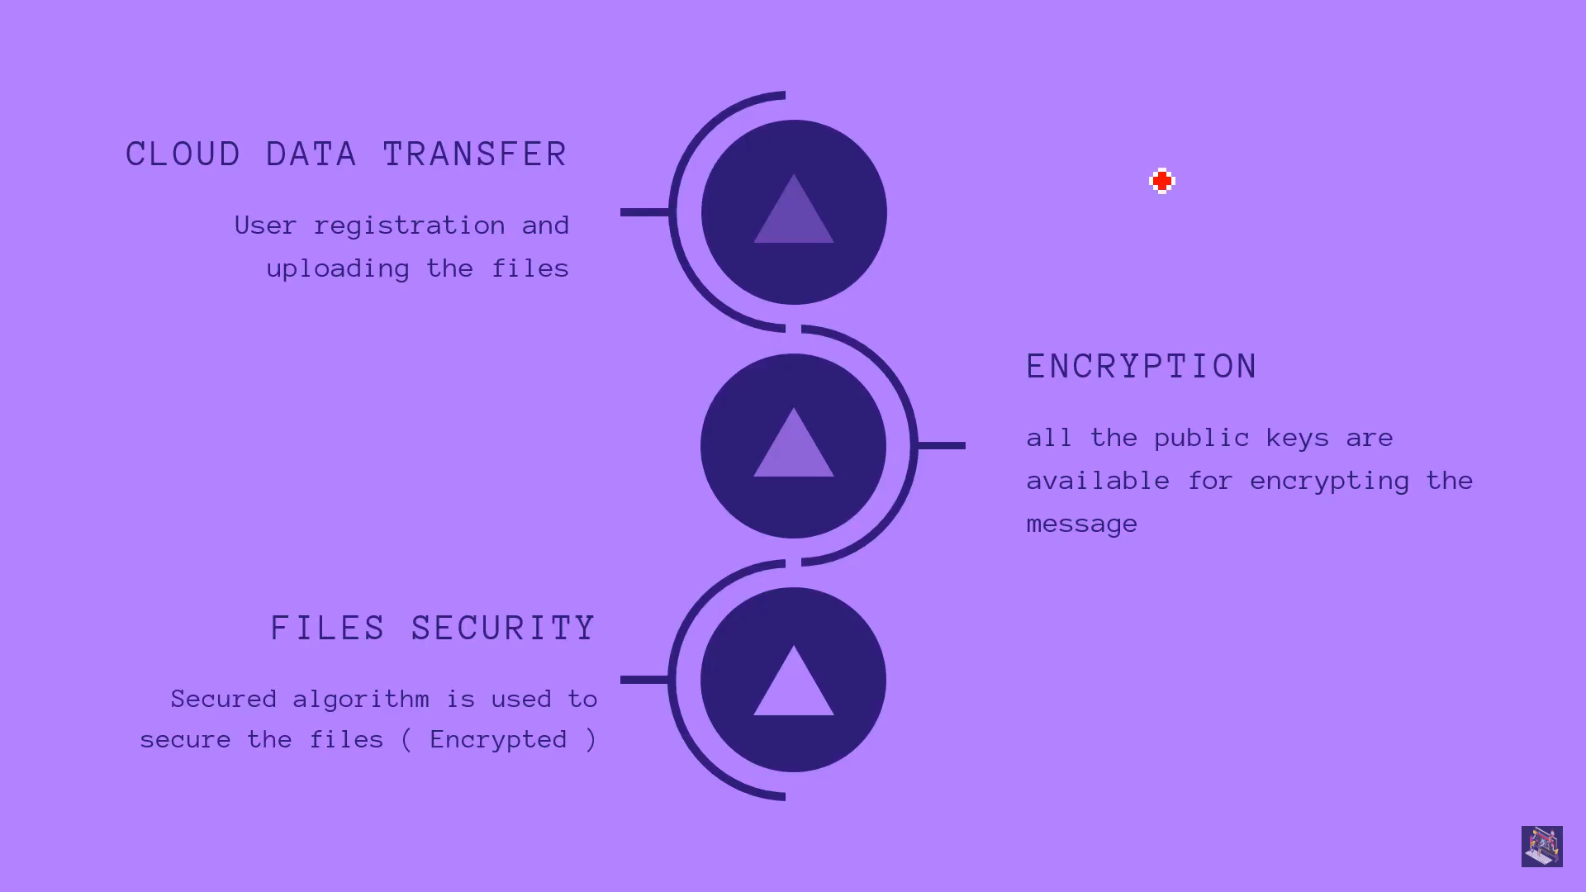

Slide 7
ENCRYPTION
Organizations and individuals also commonly use encryption to protect sensitive data stored on computers, servers and mobile devices like phones or tablets. There are various encryption techniques that are present some of which are:
Triple DES
Blowfish
RSA
Two fish
AES

Slide 8

FILE TRANSFER
In File Transfer Module, students can upload their resume, certificates and images while filling student's academic information form. Those files will be transmitted in encrypted format and will be stored in cloud in plain text format.
31
5:31
32
0:41
need to provide security to the uploaded file. This is because attacker can attack thefile and he will able to do following various types of attacks: -
Reading contents of file.
Viewing and copying of image present in resume.
Attacker can also modify the contents of file.
Attacker can misuse the authorized documents like Certificates.

Slide 9


Slide 10
Presented strong security techniques to secure the data files of a data owner in the cloud infrastructure. In our proposed scheme, we have mainly tried to maintain the integrity and privacy of the stored data. The public key, hash, and private key ciphers used between the sender and receiver ensure a secure environment at the cloud. Future extensions include conducting an online aptitude test for the eligible students and providing security to the same.
CONCLUSION

